Slide 1

Cost-effective Customer Targeting Strategy to Achieve Business Growth
Ziyang (Zion) GAO
2001213232
Quantitative Marketing Models
Guanghua School of Management, Peking University

Slide 2

Case Scenario
Our client, a commercial bank in Hong Kong, are now planning to conduct direct marketing campaigns (phone calls) to promote term deposit.
We know that the average cost for the client to contact a customer is 10 dollar, and each successful customer acquisition will bring a 100 dollar revenue.
Please utilize the data collected by our client's marketing team and develop a customer targeting strategy that achieve the maximum possible revenue with least marketing expenditure.

Slide 3
Data
The dataset is consisted of 4,251 customer data on direct marketing campaigns (phone calls) of a Hong Kong banking institution, with 17 variables:
Client Information:
(1) age; (2) job: type of job; (3) marital: marital status;
(4) education; (5) default: whether or not has credit in default;
(6) balance: average yearly balance;
(7) housing: whether or not has housing loan;
(8) loan: whether or not has personal loan.
Outcome:
(9)response: whether or not has the client subscribed a term deposit.

Slide 4
Data
Campaign Information:
(10) contact: contact communication type;
(11) day: last contact day of the week;
(12) month: last contact month of year;
(13) duration: last contact duration, in seconds.**
Other Information:
(14) campaign: number of contacts performed during this campaign and for this client;
(15) pdays: number of days that passed by after the client was last contacted from a previous campaign;
(16) previous: number of contacts performed before this campaign and for this client;
(17) poutcome: outcome of the previous marketing campaign.
Notes:
**Note: This attribute highly affects the outcome variable (e.g., if duration=0 then response=’no’). Yet, the duration is not known before a call is performed. Also, after the end of the call response is obviously known. Thus, this variable should only be included for benchmark purposes and should be discarded if the intention is to have a realistic predictive model.

Slide 5
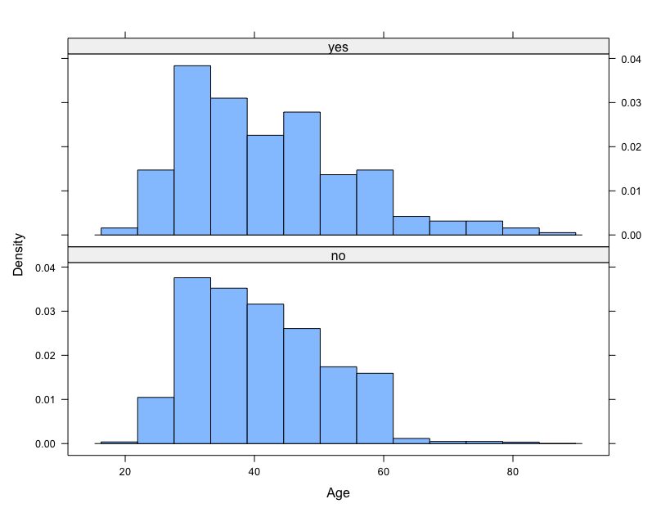
Client Response in Different Segment
Clients who subscribed a term deposit are mainly in between late twenties and 60 years old, though those in early sixties seem to have a higher probability to subscribe.

Slide 6
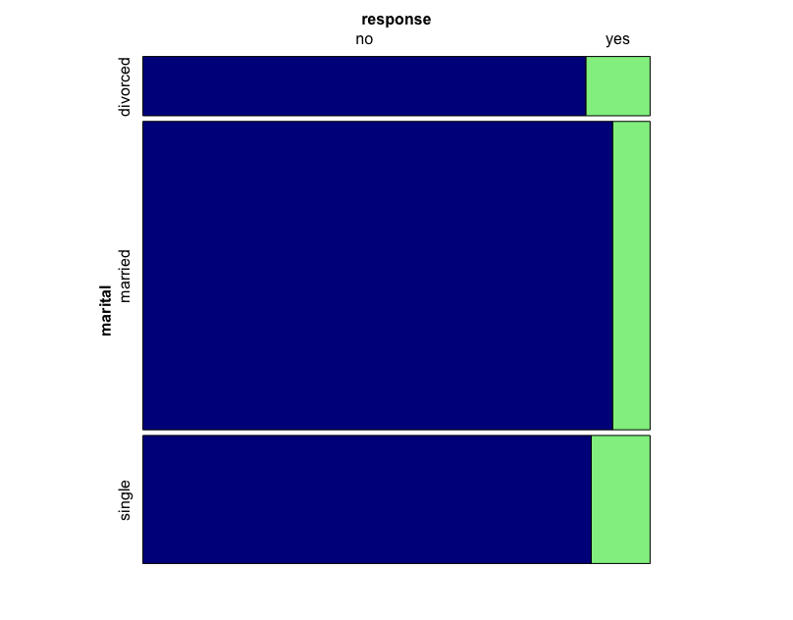
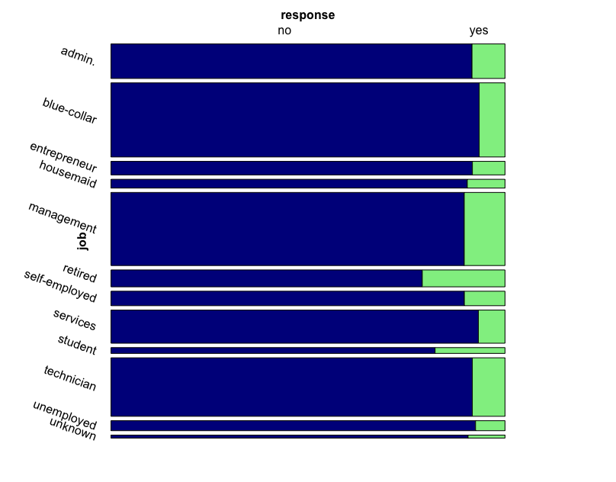
Client Response in Different Segment
Most married clients seem less likely to subscribe a term deposit, clients who are retired or in school seem to be more inclined to subscribe.

Slide 7
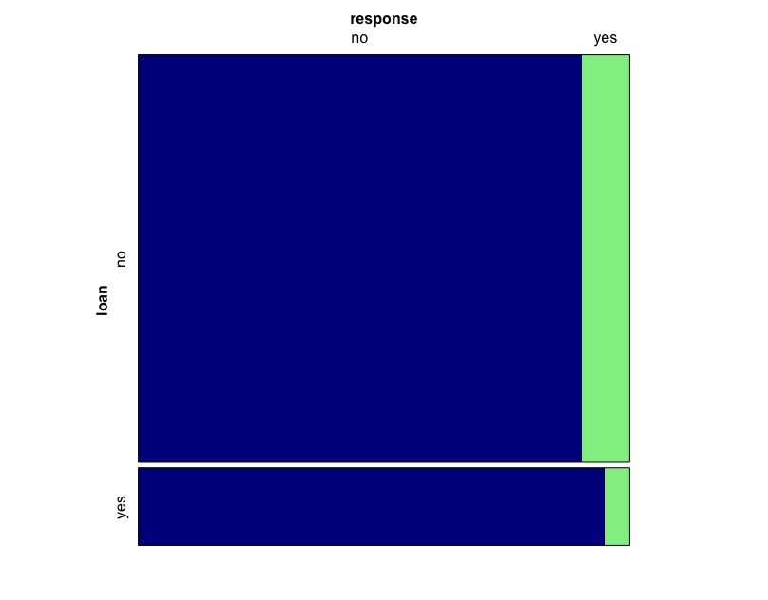
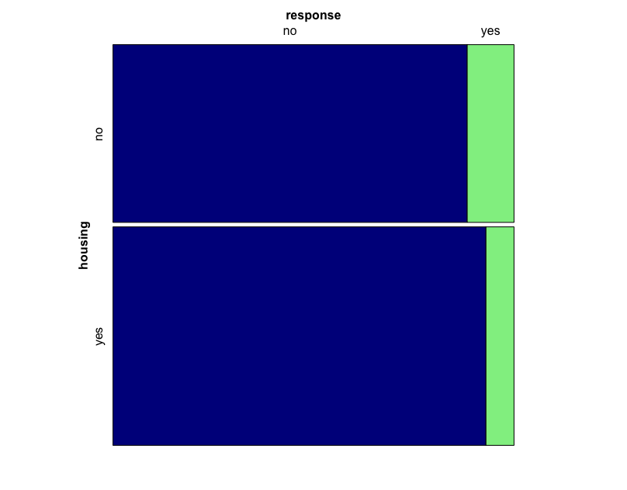
Client Response in Different Segment
Clients who are free from personal loan or housing loan seem to have higher propensity to subscribe a term deposit.

Slide 8
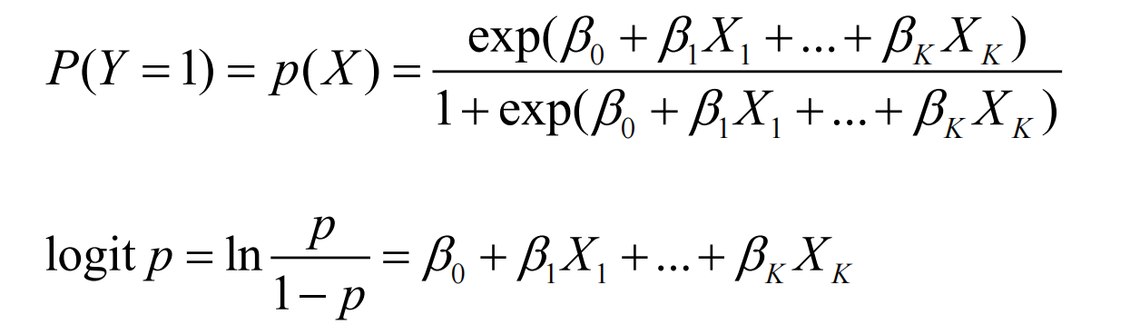
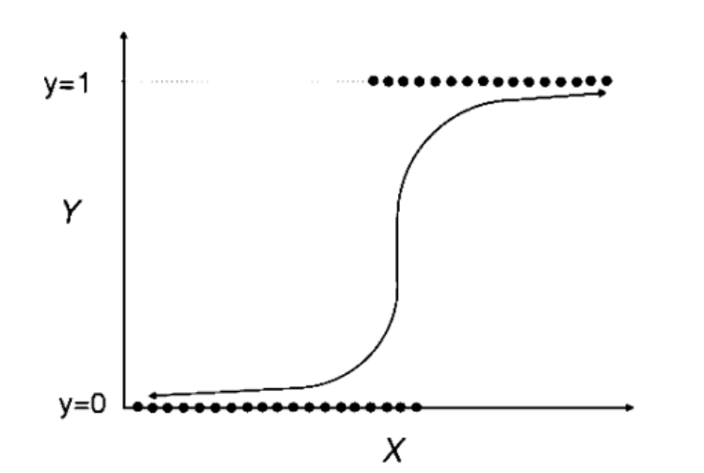
Logistic Regression
Logistic regression (LR) operates a smooth nonlinear logistic transformation over a multiple regression model and allows the estimation of class probabilities;
Train a logistic regression model based on all the client features, and then compute the propensity for each client to subscribe a term deposit;
Then a class can be assigned from a probabilistic outcome by assigning a threshold D, such that “response=YES” is true if P(Y=1|Xk) > D .
Notes:
where p(c|x) denotes the probability of class c given the k-th input example xk = (xk,1, ..., xk,M ) with M features and wi denotes a weight factor, adjusted by the learning algorithm. Due to the additive linear combination of its independent variables (x), the model is easy to interpret.

Slide 9
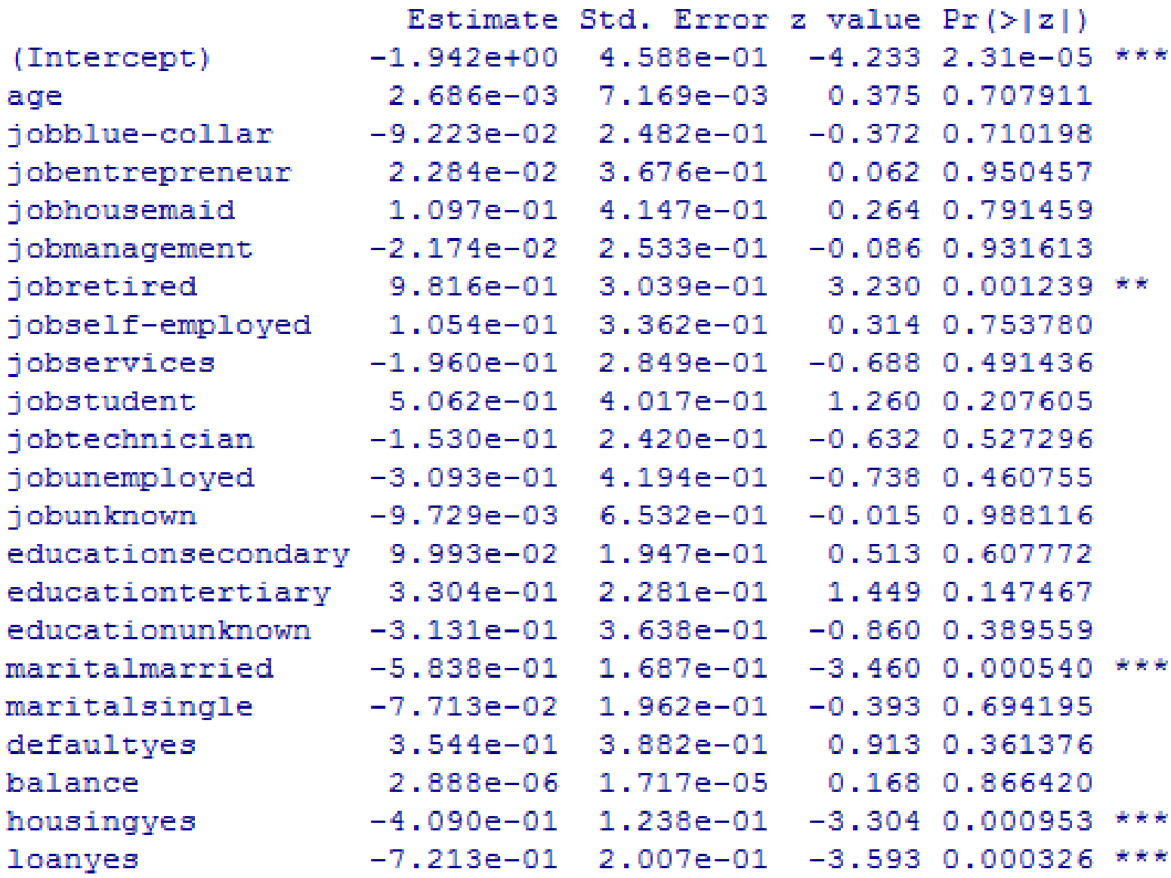
Logistic Regression

Slide 10
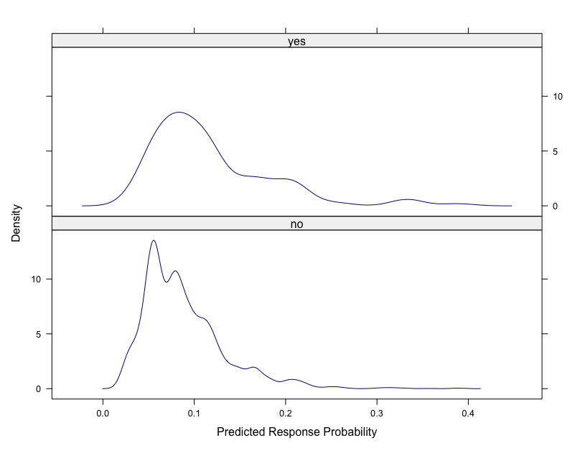
Logistic Regression
For clients who did not subscribe, the predicted propensities are densely distributed below 0.1, while more than half of the clients who did subscribe have predicted propensities above 0.1 .

Slide 11
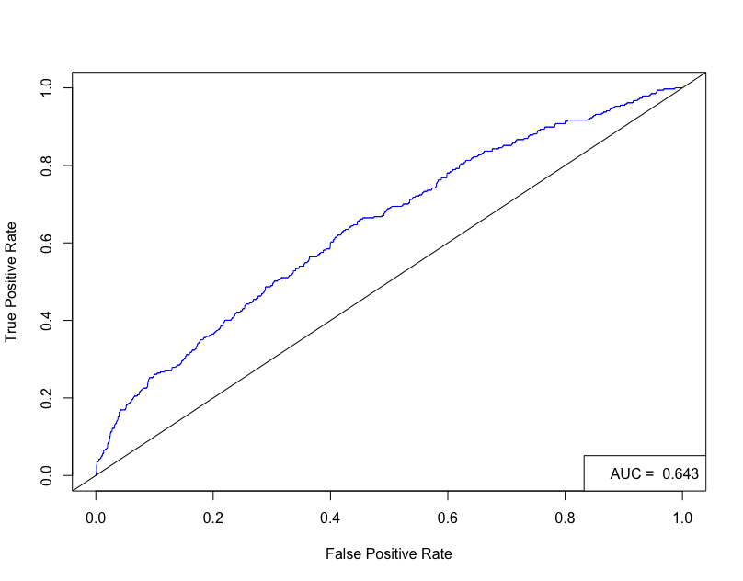
Logistic Regression
A perfect classification model should present an AUC of 1.0, while an AUC of 0.5 denotes a random classifier. For the trained LR model, AUC=0.643>0.5 .
Notes:
The receiver operating characteristic (ROC) curve shows the performance of a two class classifier across the range of possible threshold (D) values, plotting one minus the specificity (x-axis) versus the sensitivity (y-axis)
The overall accuracy is given by the area under the curve (AUC), measuring the degree of discrimination that can be obtained from a given model. AUC is a popular classification metric that presents advantages of being independent of the class frequency or specific false positive/negative costs.
A good model should offer the best compromise between a desirable a high true positive rate (TPR) and low false positive rate (FPR). The former goal corresponds to a sensitive model, while the latter is related with a more specific model. The advantage of the ROC curve is that the domain user can select the best TPR and FPR trade-off that serves its needs.
FPR = FP / (TN + FP)
TPR = TP / (FN + TP)

Slide 12
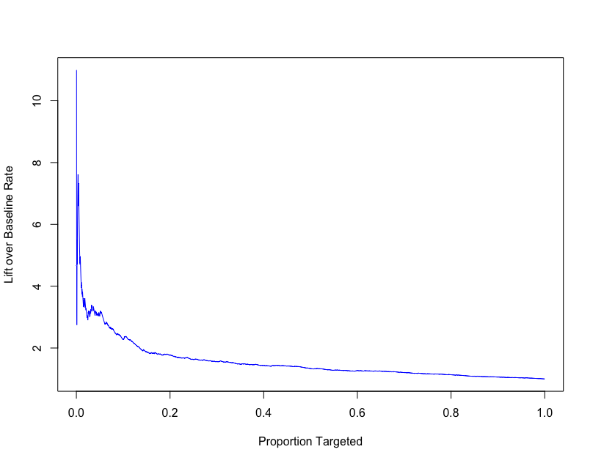
Logistic Regression
If we choose 10% of the clients to target, using LR and target the top 10% that has the highest propensity would yield more than 2 times more of positive response than targeting randomly.
Notes:
In the domain of marketing, the Lift analysis is popular for accessing the quality of targeting models.
Usually, the population is divided into deciles, under a decreasing order of their predictive probability for success.
A useful Lift curve is obtained by plotting the population samples (ordered by the deciles, x-axis) versus the proportion of real responses captured compared with randomly targeting (y-axis).

Slide 13
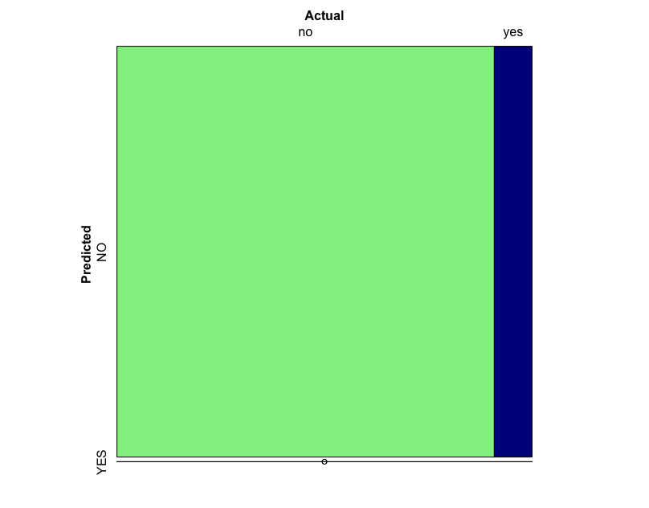
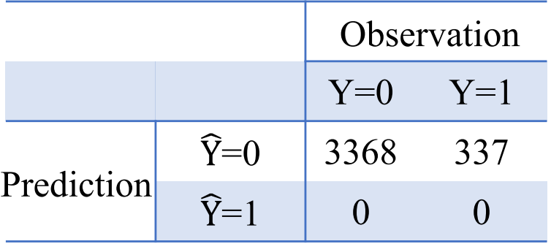
Target Segment Selection
if we set threshold D=0.5 and view customers with predicted propensities greater than it as target segment, then:
we would have a relatively high prediction accuracy, but a low precision and recall (both 0), and our prediction model would suggest us to target 0 client.
Notes:
accuracy = (TN + TP) / N
error rate = (FN + FP) / N
precision = TP / (TP + FP)
recall = TP / (FN + TP)

Slide 14
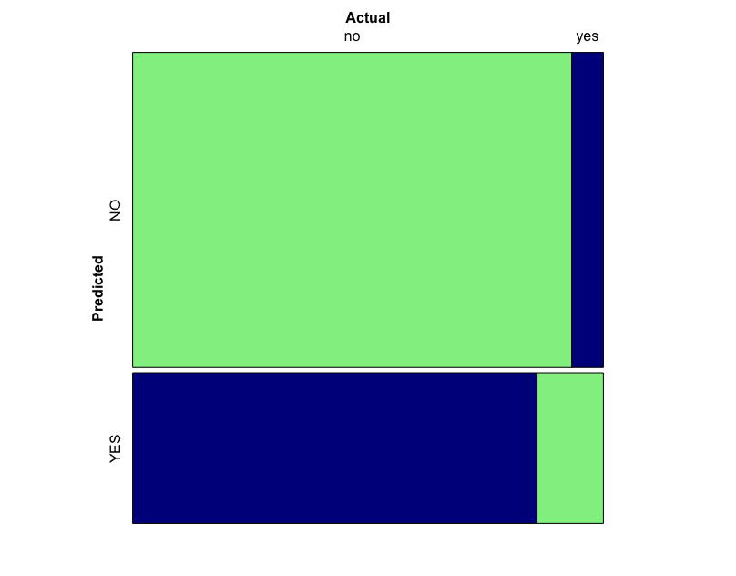
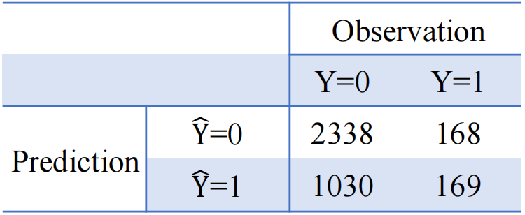
Target Segment Selection
on the other hand, if we set threshold D=0.1 , then:
we would have a lower prediction accuracy (68%), but a higher precision (14.1%) and recall (50.1%), and our prediction model would suggest us to target 1199 clients, among which 169 clients would subscribe a term deposit.
Notes:
accuracy = (TN + TP) / N
error rate = (FN + FP) / N
precision = TP / (TP + FP)
recall = TP / (FN + TP)

Slide 15
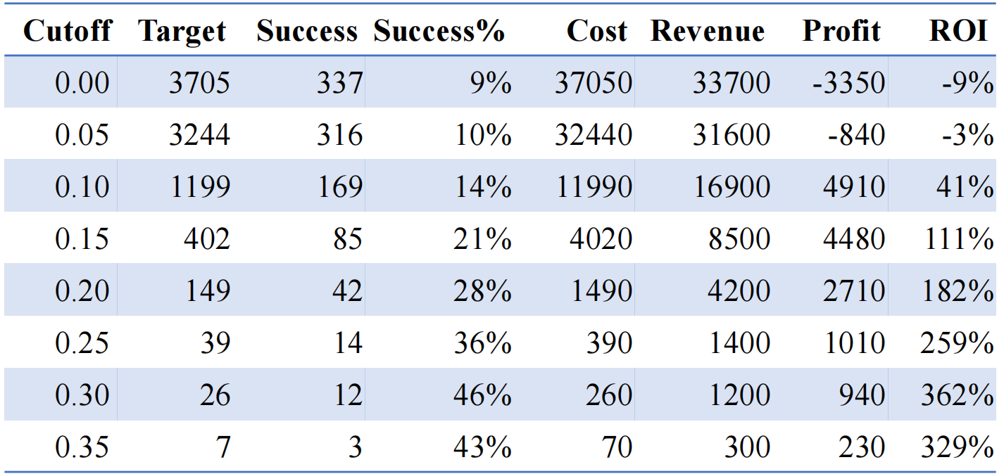
Cost-benefit Analysis
As we set the classification threshold (cutoff value) higher, our model would suggest us to target less clients, though targeting accuracy and ROI keeps increasing, profitability first increase then drop, set D = 0.1 would be ideal to achieve maximize profit.
Notes:
The success rate of random targeting is 337 / (3368 + 337) = 9%

Slide 16
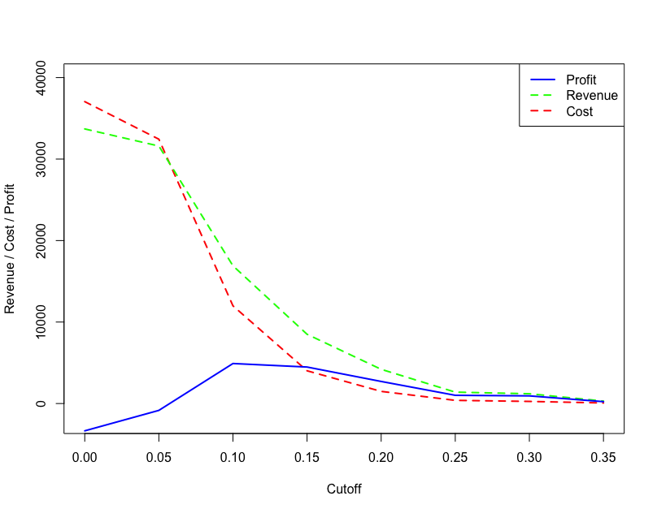
Cost-benefit Analysis

Slide 17

Conclusions and Suggestions
1
Use logistic regression model (AUC=0.643) in managerial decision making and only target the segment of bank client with higher possibility to subscribe a term deposit would generate higher ROI and profit.
2
When targeting bank clients with predicted subscription propensities higher than 0.1, the estimated ROI of telemarketing is 111%, if this model were incorporated into previous marketing efforts, marketing profit would have a 8260 dollar increase.
3
Other machine learning models may also have the potential for the task, campaign information and marco economic data may be included in future modeling to improve performance metrics.
Notes:
4910-(-3350)=8260

Slide 18

THANK YOU
Empower Marketing Practice with Data Science

